Slide 1
Büyük Veriye Giriş
Nur Banu Oğur, PhD
BBBF 1204

Slide 2
Notlandırma Ölçeği
Vize 40%
Ödev 10 %
Ödev 10 %
Proje 40%
Final 50%
Ara sınav ve final kapsamlı olacak, dersleri ve ödevleri kapsayacaktır.

Slide 3

Materyaller
• Stanford University, Computer Science Course
- CS246: Mining Massive Datasets
- CS345A: Data Mining
Anand Rajaraman and Jeffrey David Ullman
Available online at: http://infolab.stanford.edu/~ullman/mmds.html
• Brigham Young University, Big Data Science & CAPSTONE Course
Available online at: http://bigdata.cs.byu.edu/
Book
1- Hands-On Big Data Modeling, James Lee, Tao Wei, Suresh Kumar Mukhiya
2- An Introduction to Data Science (2013) 3rd edition , Jeffrey Stanton
3- Big Data Fundamentals, Thomas Erl, Wajid Khattak, Paul Buhler
4- R Programming for Data Science(2016), Roger D. Peng.
5- Big Data: Principles And Best Practices of Scalable Real-Time Data Systems, Nathan Marz with James Warren
6- Mining of Massive Datasets 2nd edition

Slide 4
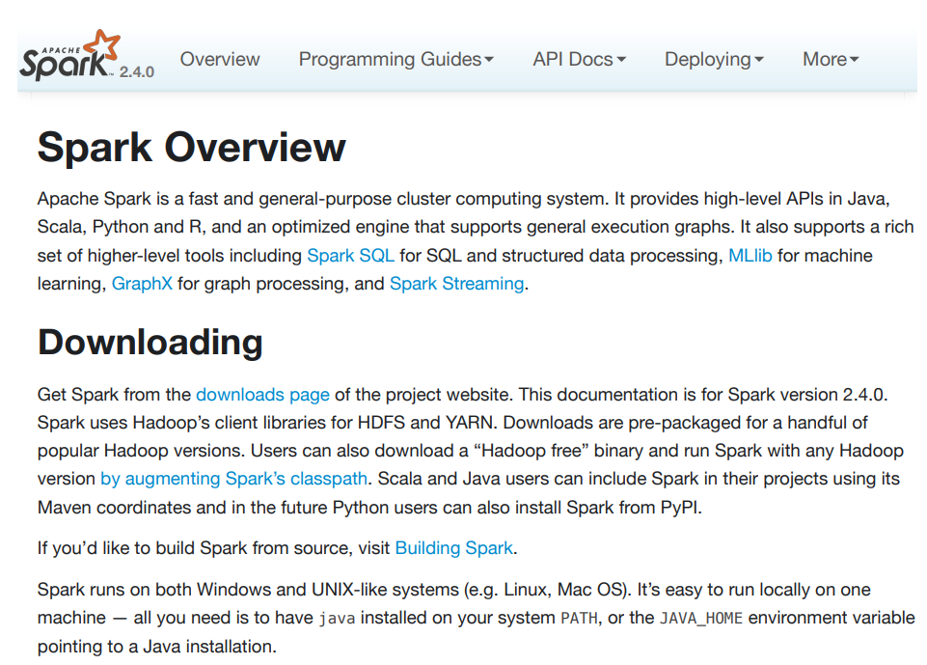


Slide 5
Ders Konuları
Büyük Veriye Giriş, Temel bilgilendirme
Büyük Veri Kullanım Alanları
Python-Data Structure
Python-NumPy, Pandas
Python-ScikitLearn
OpenSource Technologies-Hadoop
Apache Pig&Hive
Apache Spark
Apache Streaming
Machine Learning, Apache Mllib
Spark Uygulamaları
Kafka&Zookeeper
Cloud Technologies-Big Data Clustering
Proje Sunumları

